Slide 1
Reading and Writing Files
The function f=open(filename, mode) opens a file for reading or writing.
mode can be:
  “r” – Reading
  “w”- Writing
  “a”- Append
  “r+”- Open for both reading and writing.
  “b” – Open the file in binary mode (only in Windows)

Slide 2
File Input/Output
input_file = open(“in.txt")
output_file = open(“out.txt", "w")
for line in input_file:
output_file.write(line)
“w” = “write mode”
“a” = “append mode”
“wb” = “write in binary”
“r” = “read mode” (default)
“rb” = “read in binary”
“U” = “read files with Unix
or Windows line endings”

Slide 3
Reading a file
s = f.read(size)
  It will read size characters from the file and place it in string s.
s = f.read()
  It reads the entire file and places it in string s.
s = f.readline()
  It reads a single line from the file.
l = f.readlines()
  It returns a list with all the lines in the file.

Slide 4
Writing to a file
f.write(s)
  It write string s to file f.
f.seek(pos)
  Changes the fileposition to pos
f.close()
  It closes the file

Slide 5
Reading Files
name = open("filename")
  opens the given file for reading, and returns a file object
name.read() - file's entire contents as a string
name.readline() - next line from file as a string
name.readlines() - file's contents as a list of lines
  the lines from a file object can also be read using a for loop
>>> f = open("hours.txt")
>>> f.read()
'123 Susan 12.5 8.1 7.6 3.2\n
456 Brad 4.0 11.6 6.5 2.7 12\n
789 Jenn 8.0 8.0 8.0 8.0 7.5\n'

Slide 6
File Input Template
A template for reading files in Python:
name = open("filename")
for line in name:
statements
>>> input = open("hours.txt")
>>> for line in input:
... print(line.strip()) # strip() removes \n
123 Susan 12.5 8.1 7.6 3.2
456 Brad 4.0 11.6 6.5 2.7 12
789 Jenn 8.0 8.0 8.0 8.0 7.5

Slide 7
Exercise
Write a function input_stats that accepts a file name as a parameter and that reports the longest line in the file.
  example input file, carroll.txt:
  Beware the Jabberwock, my son,
  the jaws that bite, the claws that catch,
  Beware the JubJub bird and shun
  the frumious bandersnatch.
  expected output:
>>> input_stats("carroll.txt")
longest line = 42 characters
the jaws that bite, the claws that catch,

Slide 8
Exercise Solution
  def input_stats(filename):
  input = open(filename)
  longest = ""
  for line in input:
  if len(line) > len(longest):
  longest = line
  print("Longest line =", len(longest))
  print(longest)

Slide 9
String Splitting
split breaks a string into tokens that you can loop over.
  name.split() # break by whitespace
  name.split(delimiter) # break by delimiter
join performs the opposite of a split
  delimiter.join(list of tokens)
>>> name = "Brave Sir Robin"
>>> for word in name.split():
... print(word)
Brave
Sir
Robin
>>> "LL".join(name.split("r"))
'BLLave SiLL Robin

Slide 10
Splitting into Variables
If you know the number of tokens, you can split them directly into a sequence of variables.
  var1, var2, ..., varN = string.split()
may want to convert type of some tokens: type(value)
>>> s = "Jessica 31 647.28"
>>> name, age, money = s.split()
>>> name
'Jessica'
>>> int(age)
31
>>> float(money)
647.28

Slide 11
Tokenizing File Input
Use split to tokenize line contents when reading files.
  You may want to type-cast tokens: type(value)
>>> f = open("example.txt")
>>> line = f.readline()
>>> line
'hello world 42 3.14\n'
>>> tokens = line.split()
>>> tokens
['hello', 'world', '42', '3.14']
>>> word = tokens[0]
'hello'
>>> answer = int(tokens[2])
42
>>> pi = float(tokens[3])
3.14

Slide 12
Exercise
Suppose we have this hours.txt data:
  123 Suzy 9.5 8.1 7.6 3.1 3.2
  456 Brad 7.0 9.6 6.5 4.9 8.8
  789 Jenn 8.0 8.0 8.0 8.0 7.5
Compute each worker's total hours and hours/day.
  Assume each worker works exactly five days.
  Suzy ID 123 worked 31.4 hours: 6.3 / day
  Brad ID 456 worked 36.8 hours: 7.36 / day
  Jenn ID 789 worked 39.5 hours: 7.9 / day

Slide 13
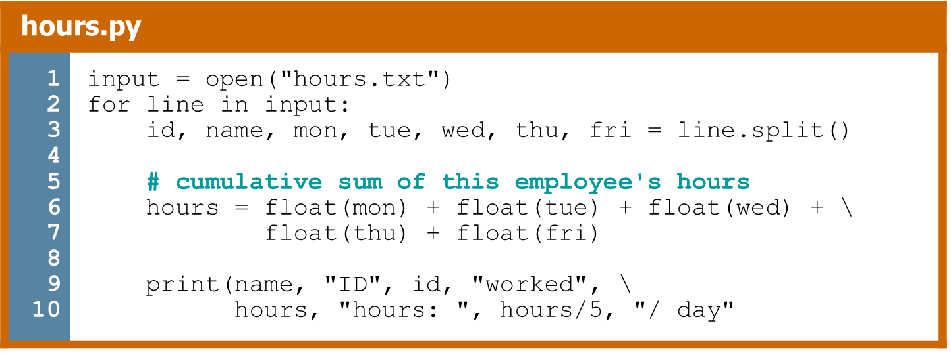
Exercise Answer

Slide 14
Writing Files
name = open("filename", "w")
name = open("filename", "a")
  opens file for write (deletes previous contents), or
  opens file for append (new data goes after previous data)
name.write(str) - writes the given string to the file
name.close() - saves file once writing is done
>>> out = open("output.txt", "w")
>>> out.write("Hello, world!\n")
>>> out.write("How are you?")
>>> out.close()
>>> open("output.txt").read()
'Hello, world!\nHow are you?'

